Slide 1

Investing in stocks.. Must you know finance?

Slide 2







Slide 3
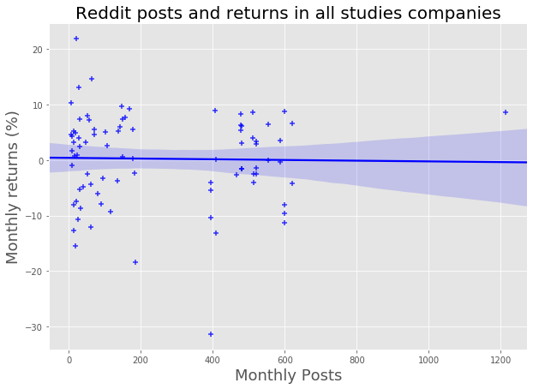

Slide 4
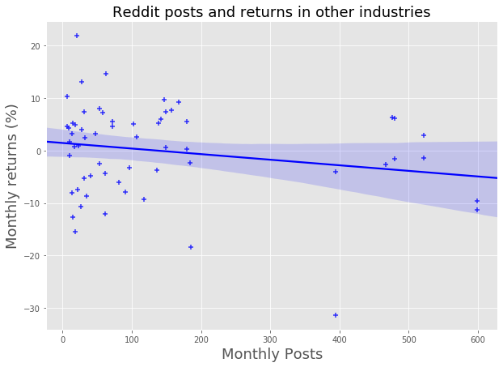

Slide 5
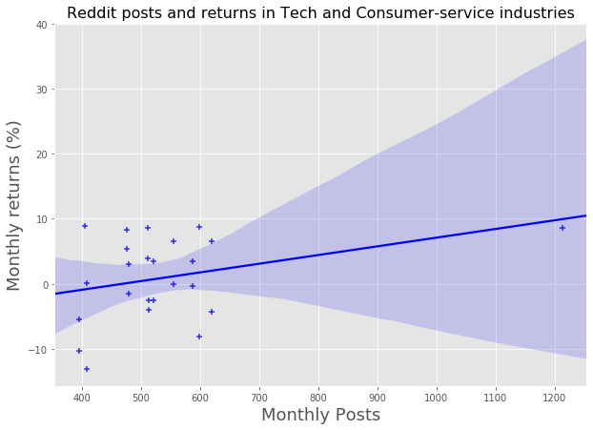

Slide 6

Strategy

